Slide 1
Async and Await
By
Samkeet Kevat,
Ayush Dhimmar.

Slide 2
Table of contents
Sync vs Async
What is Async and Await?
Promise vs Async
How to use Async and example
Advantages of Async over Promise
Code and Example

Slide 3
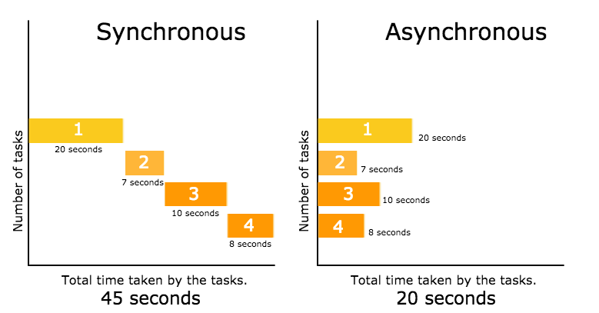
Sync vs Async

Slide 4
What is Async and Await?
The async and await keywords enable asynchronous, promise-based behavior to be written in a cleaner style, avoiding the need to explicitly configure promise chains.
Async : It makes sure that a promise is returned and if it is not returned then JavaScript automatically wraps it in a promise which is resolved with its value.
Await: Await function is used to wait for the promise. It could be used within the async block only. It makes the code wait until the promise returns a result. It only makes the async block wait.
In simple words we can say
Async makes function return a promise.
Await makes function wait for a promise.

Slide 5
Promise vs Async
Promise
Async
A placeholder for Asynchronous task which is yet to be completed.
Promise has 3 states – resolved, rejected and pending.
Error handling is done using .then() and .catch() methods.
Promise chains can become difficult to understand sometimes.
A syntactic sugar for promise
It does not have any states. It returns a promise either resolved or rejected.
Error handling is done using .try() and catch() methods.
easier to read and understand the flow of the program as compared to promise chains.

Slide 6
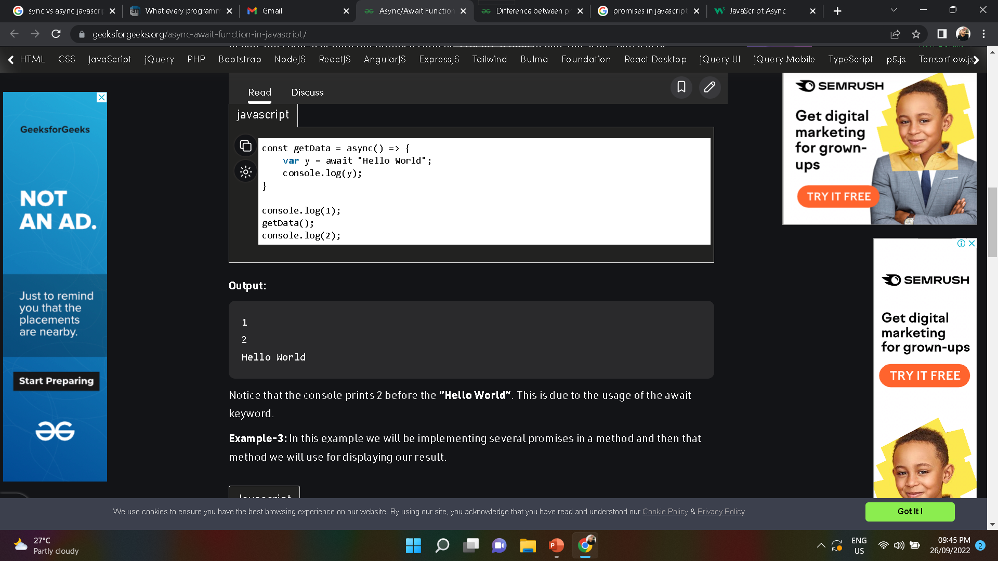
How to use Async with example
The Async keyword before a function makes it async function.
For example :
async function myFunction() { return "Hello"; }
Another example :

Slide 7
Advantages of Async
Concise and clean : we don’t have to write resolve and reject.
Error handling : we can use try/catch
Conditionals : it makes condition easier
Debugging : much easier to debug
You can await anything

Slide 8
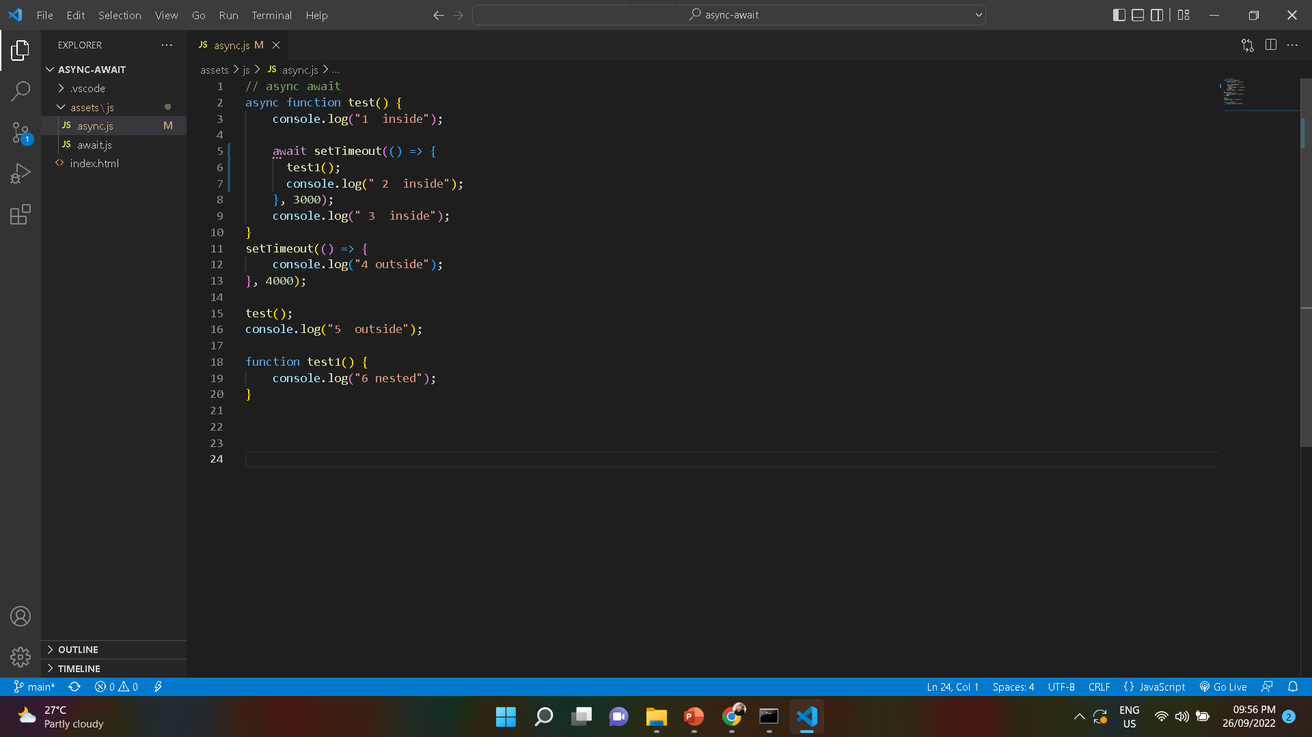
Code and Example

Slide 9
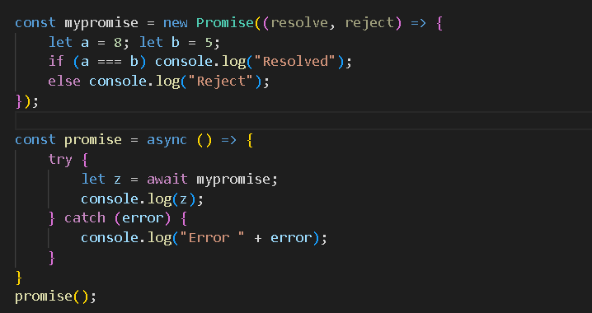
Code and Example

Slide 10
Thank you.

